Slide 1




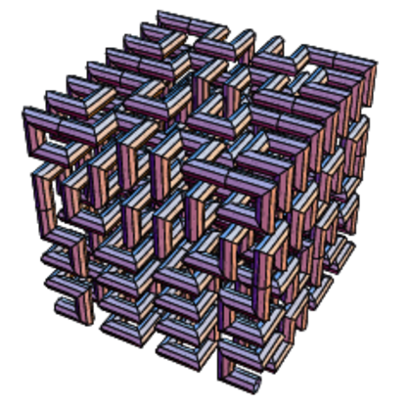
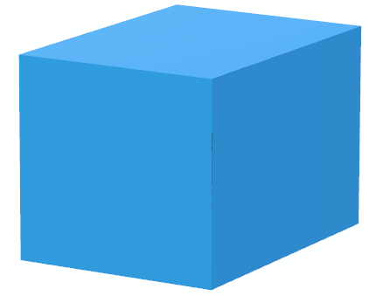
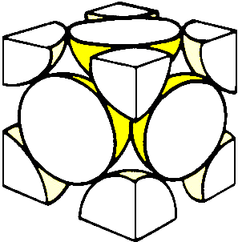
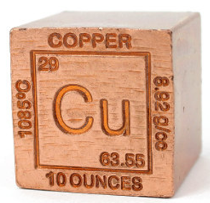
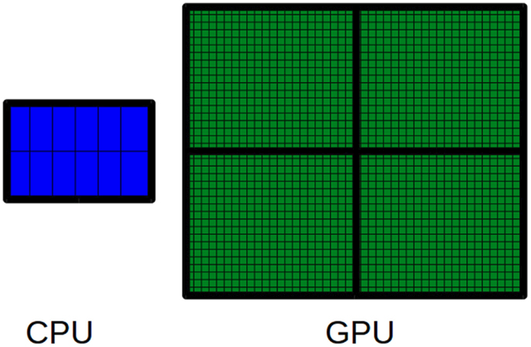
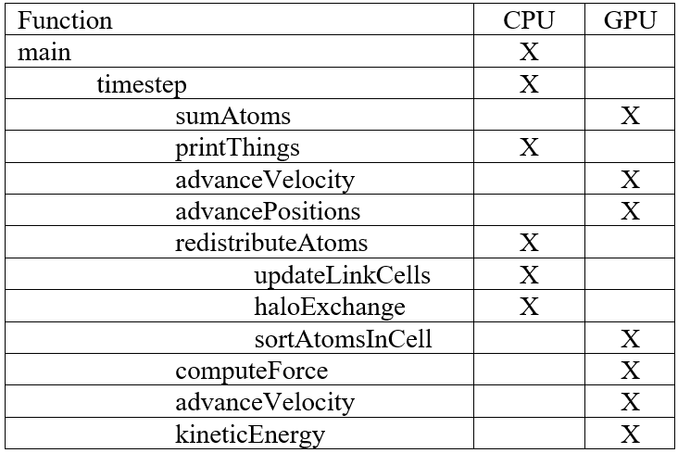

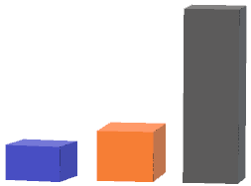
Improving Performance of Scientific Programs with OpenACC.
Frank Kornet HCC, Houston, TX (frkornet@gmail.com)
Mentor: Millad Ghane, University of Houston, Houston, TX (millad.mg@gmail.com)
NSF Grant: PHY-1427654
Parallel Programming
Objectives
Algorithmic Behavior
Force model: Embedded Atom Model
Simulating 500,000 atoms for 100 steps on one node with 2 x K80.
#pragma acc parallel loop
for (int i=nLocalBoxes;
i < nTotalBoxes;
++i)
s_boxes_nAtoms[i] = 0;
Demonstrate that OpenACC’s performance is within 10 – 20 per cent of CUDA’s performance
60
Modified OpenACC
O(N²)
Demonstrate that OpenACC is easier to use and more productive than CUDA
CUDA
Personal: learn parallel programming concepts and physical concepts behind the Verlet algorithm
Runtime (sec)
30
Example of OpenACC compiler directive.
Use CoMD as Proxy
O(N)
Why Parallel Programs?
Molecular dynamics (MD) is the method of simulating the kinetic and thermodynamic properties of molecular systems using Newton’s equations of motion and represents an important class of scientific applications. CoMD is used as it is both small and representative of this class. It carries out a microcanonical ensemble simulation (NVE) and is developed by DoE Co-design Center for Materials in Extreme Environments (ExMatEx).
32,000
Atoms
500,000
Moore’s law running out of steam and scientific applications will no longer get an automatic performance boost
Force model: Embedded Atom Model (EAM)
Simulating 100 steps on single node with 2 x K80.
CUDA Modifications
Scientific applications need to run ever larger simulations. To do so, they need to become faster
Hilbert Curve
to improve
texture caching
Atom
Neighbor list
y
Number of Atoms
4 * X * Y * Z
v
v
v
The only realistic way to increase performance is by writing parallel programs
Neighbor Atoms w/in cutoff
Force Calculation
Neighbor Cells
Parallel Streams
Sort Atoms
Stream 1
Stream 2
Halo
Cells
Force Model
Lennard-Jones & EAM
(pair-wise with cutoff)
EAM-1/2
interior
Halo
Exchange
CPU and GPU Cores
x
Sync
EAM-1/2
boundary
z
System broken up in unit cells
Face-centered cubic (FCC)
Copper periodic table
EAM-3
interior
Force
Exchange
Fat Core
3,000 GFLPS (K80)
Thin Core
Sample Screen Output
Sync
EAM-3
boundary
Only sort atoms in Halo Cells
Optimize sort (hashing)
Constant
Variable
Constant
Source: http://on-demand.gputechconf.com/gtc/2014/presentations/S4465-optimizing-comd-molecular-dynamics.pdf
# Loop Time(fs) Total Energy Potential Energy Kinetic Energy Temperature Performance # Atoms
0 0.00 -3.46052323 -3.53807922 0.07755599 600.0000 0.0000 32000
10 10.00 -3.46052263 -3.52992415 0.06940151 536.9142 0.9557 32000
Conclusions
100 GFLPS (i7 6 cores)
OpenACC vs CUDA is not a like for like comparison. It is unclear, though, which of the changes result in the different algorithmic behavior
Central Processor
Unit (CPU)
Graphics Processor Unit (GPU)
Total Energy = Potential Energy + Kinetic Energy
Study Focus
CoMD implements an O(N²) Verlet algorithm. For large simulations, CoMD will split the system and distribute cells over participating nodes.
A partial OpenACC version and a full CUDA version are available on GitHub and are used in the study.
OpenACC is easier to use and needs less code than CUDA, but different algorithm overstates CUDA part
CUDA vs OpenACC
Change Made
Results
 | OpenACC Original | OpenACC Modified | CUDA
Lines of Code | 6,200 | 6,900 | 13,000
 | CUDA | OpenACC
Platforms | NVIDIA GPUs only | CPUs and GPUs
Languages | Fortran and C/C++ | Fortran and C/C++
Usage | Function call | Compiler directive
Level | Lower | Higher
Why is the gap
so big?
Original OpenACC
Next step: migrate haloExchange to GPU and investigate what truly drives the CUDA algorithm
(*)
56
Modified OpenACC
61
(*)
48
56
CUDA
Hypothesis:
6
6
48
7
Personal objectives:
OpenACC performs at similar levels than CUDA
(*)
Elapsed Time (sec)
Speedup vs Serial
Different
algorithms?
OpenACC | Verlet | Physics
OpenACC easier to use and more productive than CUDA
(*)
√
√
50/50
(*) Basic Momentum Verlet algorithm (2nd version) as described in http://www.chem.utoronto.ca/~jmschofi/simulation/partmd.pdf
Force model: EAM. Simulating 500,000 atoms (100 steps) on single node with 2 x K80.
I enjoyed learning about physics!

